Slide 1
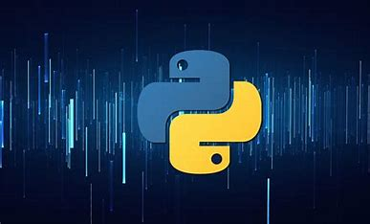
Full Stack - Artificial Intelligence
[Course]
Week 1 -
[See examples / code in GitHub code repository]
It is not about Theory, it is 20% Theory and 80% Practical –
Technical/Development/Programming [Mostly Python based]

Slide 2

Development Environment Setup
Install Python
Install – IDE - Visual Studio Code
Install – extension for Python by Microsoft
Visual Studio Code – Debugging - process
Python – executable – find version
Python File run by command prompt
Python File run by IDE – visual studio code
Python has no command for declaring a variable.
Create a free ac of GitHub. Install Desktop client. Check-in code- as per name
25

Slide 3
Development Task
Task 1:
Print – Hello World First program
Task 2:
Print – Current version of Python programming language
Task 3:
Add comments to code
Task 4:
Create a Int variable and print
Then create a string variable and print
Task 5:
Type casting – Get a type
25

Slide 4
Development Task
Data Types
Reference:
https://www.w3schools.com/python/python_datatypes.asp
https://www.geeksforgeeks.org/python-data-types/
https://www.digitalocean.com/community/tutorials/python-data-types
https://www.programiz.com/python-programming/variables-datatypes
Exercises
25

Slide 5
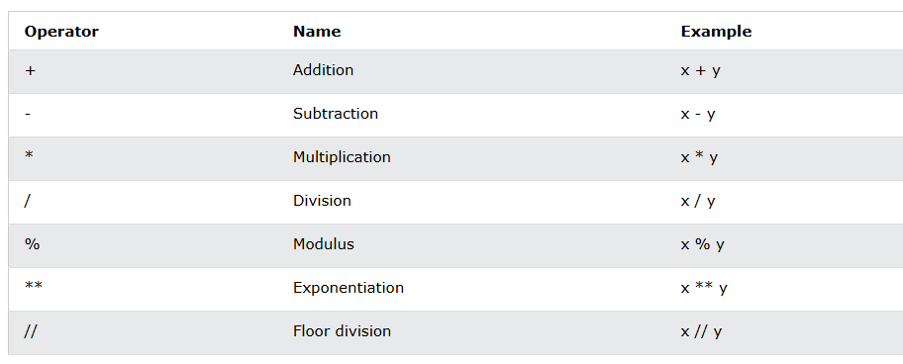
Development Task
Operators
Reference:
https://www.w3schools.com/python/python_operators.asp
https://www.programiz.com/python-programming/operators
https://www.programiz.com/python-programming/operators
https://www.scholarhat.com/tutorial/python/operators-of-python
25
Exercises

Slide 6
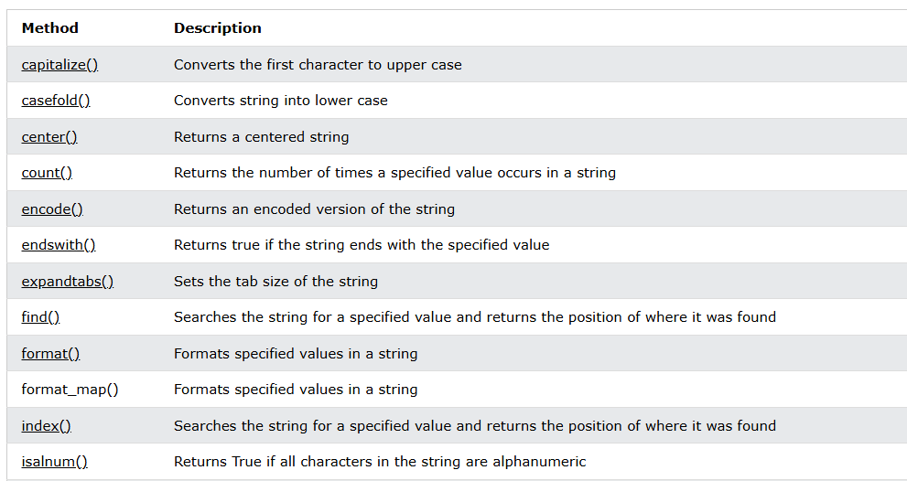
Development Task
String Function
Reference:
https://www.w3schools.com/python/python_strings_methods.asp
https://www.geeksforgeeks.org/python-string-methods/
https://www.wscubetech.com/resources/python/strings
Exercises
25

Slide 7

Development Task
Take Input
Exercises
Reference:
https://www.geeksforgeeks.org/taking-input-in-python/
https://www.digitalocean.com/community/tutorials/how-to-receive-user-input-python
https://www.w3schools.com/python/python_user_input.asp
25

Slide 8
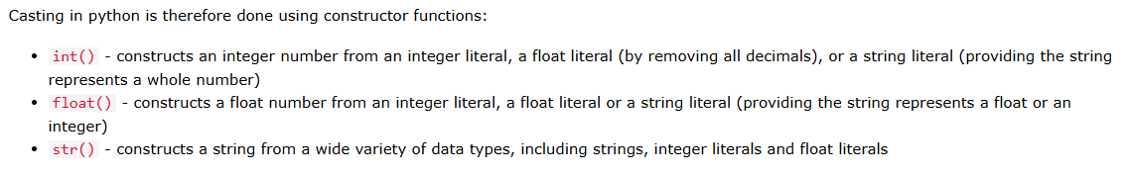
Development Task
Type-Casting
Exercises
Reference:
https://www.w3schools.com/python/python_casting.asp
https://www.geeksforgeeks.org/type-casting-in-python/
25

Slide 9
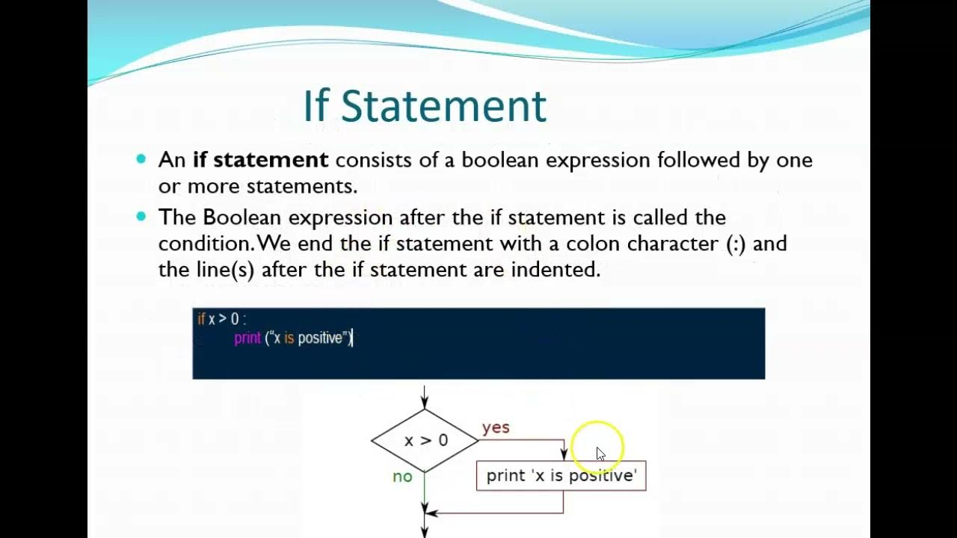
Conditional Execution
References:
https://www.geeksforgeeks.org/conditional-statements-in-python/
https://www.w3schools.com/python/python_conditions.asp
https://realpython.com/python-conditional-statements/
Exercises
25

Slide 10
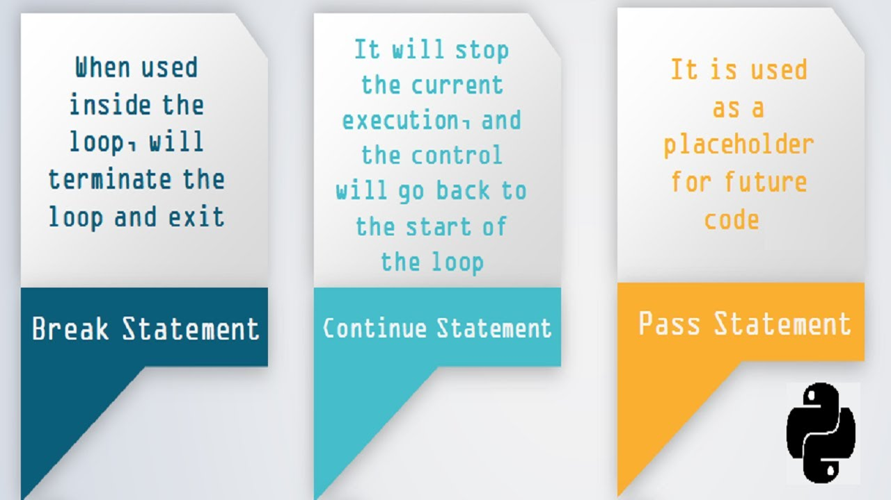
Break, continue, and pass statements
References:
https://www.digitalocean.com/community/tutorials/how-to-use-break-continue-and-pass-statements-when-working-with-loops-in-python-3
https://www.geeksforgeeks.org/loops-and-control-statements-continue-break-and-pass-in-python/
https://pynative.com/python-break-continue-pass/
Exercises
25

Slide 11
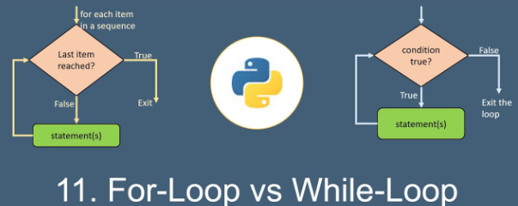
For - While - Loop
References:
https://www.geeksforgeeks.org/loops-in-python/
https://www.geeksforgeeks.org/difference-between-for-loop-and-while-loop-in-python/
https://www.w3schools.com/python/python_while_loops.asp
Exercises
25

Slide 12
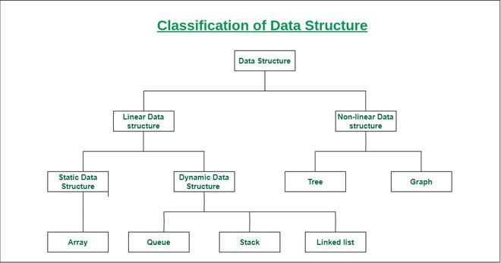
Data Structure
Data structures are the fundamental building blocks of computer programming. They define how data is organized, stored, and manipulated within a program. Understanding data structures is very important for developing efficient and effective algorithms.
References:
https://www.geeksforgeeks.org/data-structures/
https://www.simplilearn.com/tutorials/data-structure-tutorial/what-is-data-structure
25

Slide 13
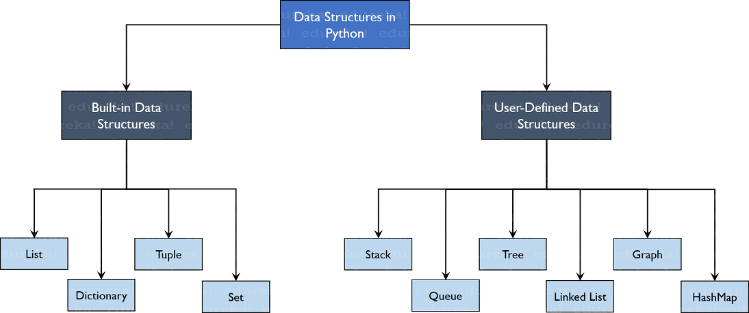
Data Structure in Python
References:
https://www.geeksforgeeks.org/python-data-structures/
https://docs.python.org/3/tutorial/datastructures.html
https://corporatefinanceinstitute.com/resources/data-science/python-data-structures/
https://www.edureka.co/blog/data-structures-in-python/
25

Slide 14
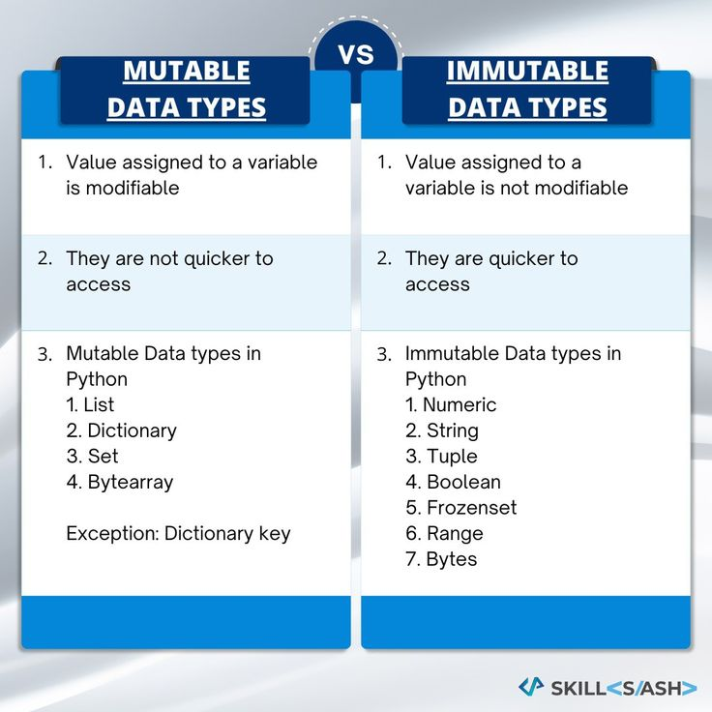
Difference between mutable and immutable
References:
https://www.geeksforgeeks.org/mutable-vs-immutable-objects-in-python/
https://realpython.com/python-mutable-vs-immutable-types/
https://www.shiksha.com/online-courses/articles/difference-between-mutable-and-immutable-in-python/
25

Slide 15
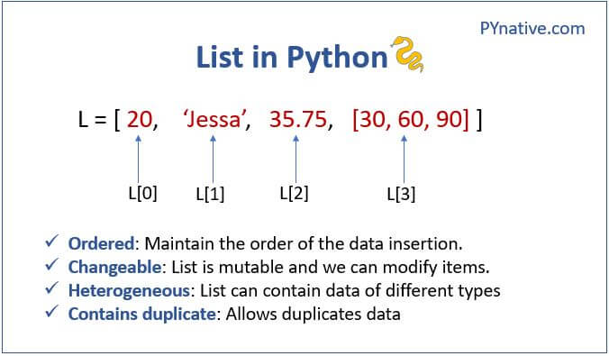
Python Lists
References:
https://www.w3schools.com/python/python_lists.asp
https://www.programiz.com/python-programming/list
https://www.geeksforgeeks.org/python-lists/
Exercises
25

Slide 16
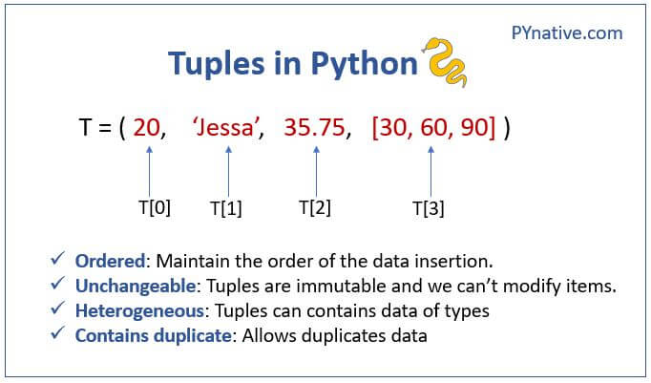
Python Tuples
References:
https://www.w3schools.com/python/python_tuples.asp
https://www.geeksforgeeks.org/tuples-in-python/
https://www.programiz.com/python-programming/tuple
Exercises
25

Slide 17
Python Sets
References:
https://www.w3schools.com/python/python_sets.asp
https://www.programiz.com/python-programming/set
https://www.geeksforgeeks.org/sets-in-python/
25
Exercises

Slide 18
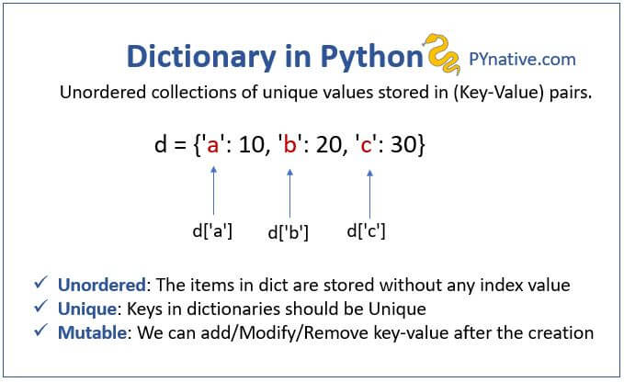
Python Dictionaries
References:
https://www.w3schools.com/python/python_dictionaries.asp
https://www.programiz.com/python-programming/dictionary
https://www.geeksforgeeks.org/python-dictionary/
25
Exercises

Slide 19

Thank you - for listening and participating
Questions / Queries
Suggestions/Recommendation
Ideas…..?
Shahzad Sarwar
Cognitive Convergence
https://cognitiveconvergence.com
shahzad@cognitiveconvergence.com
voice: +1 4242530744 (USA) +92-3004762901 (Pak)

